Slide 1
CARDIO VASCULAR RISK PREDICTION (classification problem)
By Tharunn L

Slide 2
PROBLEM STATEMENT
Visiting hospitals for regular check-ups it is almost always seen that they encourage people to get special check-ups to identify if they are at risk of heart diseases. Heart diseases have unfortunately become very common. It may be due to various reasons such as lifestyle, work pressure, lack of exercise, etc.
In this project, we will be working on predicting the 10-year risk of Coronary Heart Disease (CHD). We are given a set of variables that impact heart diseases.
These variables are related to demographic, past, and current medical history.

Slide 3
UNDERSTANDING OF CARIO VASCULAR DATASET
INDEPENDENT VARIABLES
Continuous Variables:
Age
Gender
is smoking
Cigs per day
Total Chol
Systolic BP
Diastolic BP
Body Mass
Heartrate
Glucose level
Nominal Variables:
BP Meds
Prevalent Stroke
Prevalent Hypertensive
Diabetes
Ordinal Variable:
Education
DEPENDENT VARIABLE
Binary Variable(0 or 1)
TenYearCHD

Slide 4
EXPLORATARY DATA ANALYSIS [EDA]
STEP 1: REMOVE UNWANTED COLUMNS
The first step while solving any dataset is to remove the unwanted columns from the dataset
So we have dropped id column and after having a good understanding of the Cardio Vascular Risk dataset we can say that column Education has nothing to do with patients risk of having Cardio Vascular disease. So we are dropping it.
STEP 2: IDENTIFIING AND HANDLING MISSING VALUES
We identified that total number of missing values in the dataset : 423
We have handled all the missing data in the dataset using Mean and Median approach.

Slide 5
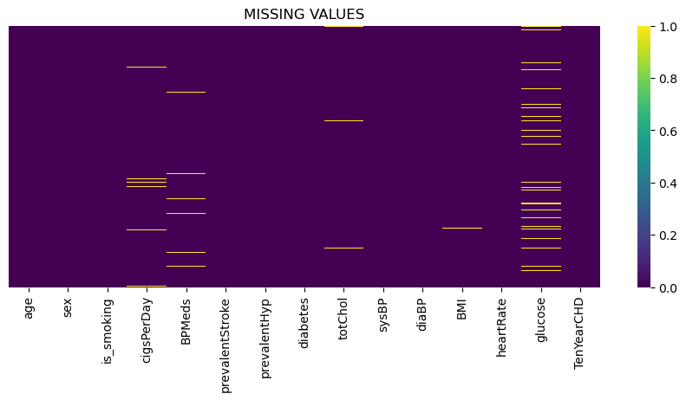
MISSING VALUES IN EACH COLUMN

Slide 6
STEP 3: LABEL ENCODEING
Two of the columns from the dataset are of type object i.e. Gender and is smoking. So we have converted those columns into type float.
STEP 4: OUTLIER TREATMENT
Although its a Classification problem I do not recommend usage of outlier treatment in Classification.
Outliers do play High Impact in Regression problem. But its not good idea to remove the data by outlier treatment, its better to do square root or log transformation in place of removing outliers.
Instead of doing outlier and then doing feature scaling, the good idea is to feature scaling directly because after feature scaling many outliers automatically come in to the range and if we are using random forest Bagging method feature scaling is also not required.(no standardization impact)

Slide 7
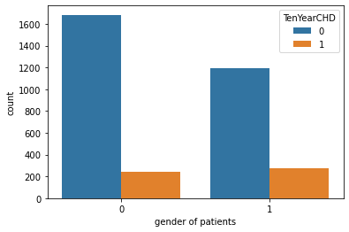
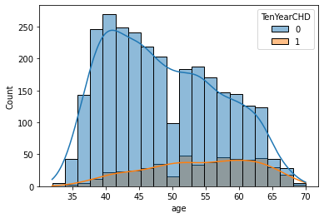
DATA VISUALIZATION

Slide 8
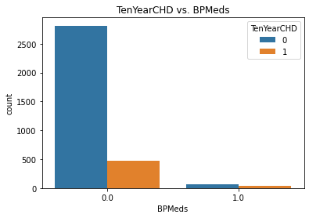
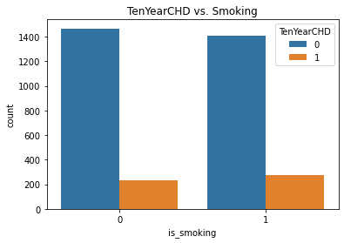
DATA VISUALIZATION

Slide 9

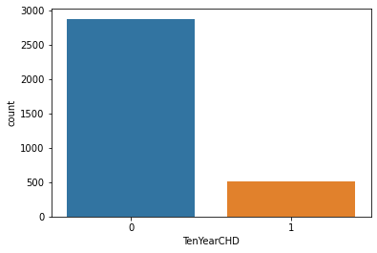
DATA VISUALIZATION
Imbalance Dataset

Slide 10
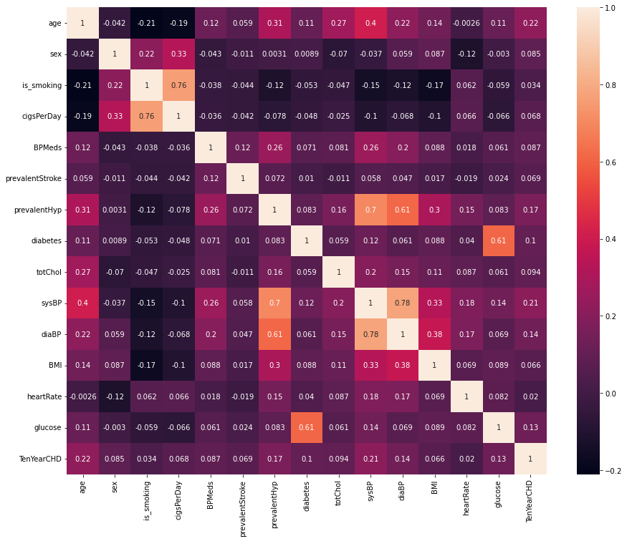
STEP 5: CHECKING FOR MULTI COLINARITY BETWEEN THE VARIABLES
If there is high corelation between more than 2 independent variables then it is called Multi collinearity. Than we can drop any of that equal Ind Variable.
This can plotted using a Heatmap for better understanding.
Actually, we are interested in classification, No need to get rid of collinear variables.
Multicollinearity mostly occurs in a regression model when two or more independent variable are highly correlated to each other.

Slide 11
EDA SUMMERY
It Is a Imbalanced Dataset. Dependent variable TenYearCHD has 2879 values as 0 and 511 values as 1.
Both Male and Female patients have equal chances of cardio vascular risk.
We can say that Cardio vascular risk is maximum at age 40-65 age.
Chances of Cardio vascular risk is very low for people who are not under any Blood
Pressure Medication.
There is similar cardio vascular risk ratios for both smokers and non smokers.
Cardio vascular risk is less for Non Diabetic patients and more in Diabetic patients.

Slide 12
STEP 6: SPLITTING DATASET INTO DEPENDENT AND INDEPENDENT VARIABLES
Once we are done with Exploratory Data Analysis we need to split the dataset into dependent and independent variables.
STEP 7: PERFORM SCALING
We are performing Feature scaling standardization to bring all the values between 0 and -3.
Scaling in performed only on independent variables.
Depending upon the nature of analysis and type of data being used we can perform Standardization or Normalization scaling techniques.
STEP 8: SPLITTING DATASET INTO TRAIN AND TEST SETS
The train-test split is used to estimate the performance of machine learning algorithms that are applicable for prediction-based Algorithms/Applications. This method is a fast and easy procedure to perform such that we can compare our own machine learning model results to machine results

Slide 13
STEP 9: BALANCING THE DATASET
A Classification data set with skewed class proportions is called imbalanced.
Classes that make up a large proportion of the data set are called majority classes.
Classes that make up a smaller proportion are minority classes.
Synthetic Minority Oversampling Technique (SMOTE) is used for handling imbalanced dataset.
SMOTE works by selecting examples that are close in the feature space, drawing a line between the examples in the feature space and drawing a new sample at a point along that line.

Slide 14
STEP 10: APPLYING MACHINE LEARNING ALGORITHUMS FOR PREDICATION
CLASSIFICAITON MODELS USED FOR CARDIO VASCULAR RISK PREDICATION
Logistic Regression
KNeighbours Classifier
Support Vector Classifier (SVM)
Decision Tree Classifier
Random Forest Classifier
Bagging Classifier
Extra Tree Classifier
Adaptive Boosting Classifier
Gradient Boosting Classifier
XGBoosting

Slide 15
STEP 11: HYPER PARAMETER TUNING
Algorithms are math their success depends on what hyper parameters were used.
They strictly control the fit of the model, for each dataset, there is a unique set of optimal hyper parameters to be found.
The most basic way of finding this perfect set would be randomly trying out different values based on gut feeling. However, this manual method becomes useless when there are many hyper parameters to tune.
Most common methods for automatic hyper parameter tuning:
1.)Random search CV
2.)Grid search CV
STEP 12: CROSS VALIDATION
Cross validation is a technique used in machine learning to evaluate the performance of a model on unseen data.
We should train our model at least 10 times using different random states and that can be easily done with the help of Cross validation

Slide 16
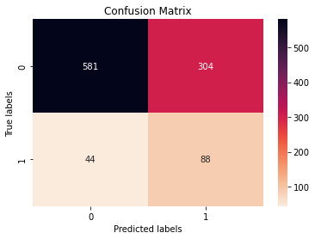
CLASSIFICATION MODEL EVALUATION TECHNIQUES
ACCURACY: It can be defined as ratio of correct predictions to total no of predications.
CONFUSION MATRIX: Confusion Matrix is a performance measurement for the machine learning classification problems where the output can be two or more classes. It is a table with combinations of predicted and actual values.
CONFUSION MATRIX gives us the understanding of True Positive, True Negative, False Negative, False Positive, Accuracy, Recall, Precision, Misclassification values.

Slide 17
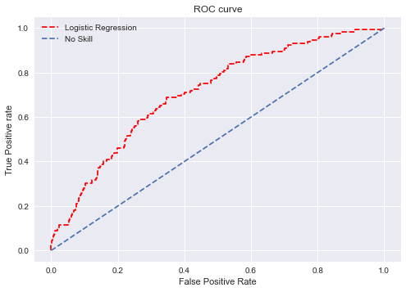
CLASSIFICATION REPORT: A classification report is a performance evaluation metric in machine learning. It is used to show the precision, recall, F1 Score, and support of your trained classification model.
ROC AUC CURVE: AUC - ROC curve is a performance measurement for the classification problems at various threshold settings. ROC is a probability curve and AUC represents the degree or measure of separability. It tells how much the model is capable of distinguishing between classes. Higher the AUC, the better the model is at predicting 0 classes as 0 and 1 classes as 1.

Slide 18
CONCLUSION
While evaluating the performance of the model Accuracy is not the only parameter to be considered in case of classification problems. Based on the problem statement we should have an idea about to which we should give more preference i.e. Precision or Recall. So for all the machine learning algorithm’s applied on the Cardio Vascular Dataset, Based on the Classification evaluation techniques used we can say that Logistic Regression, Random Forest Classifier, Bagging Classifier, Extra Tree Classifier and Ada boosting algorithm's provide us with a good training and testing accuracy and with the least False Negative values in the Confusion Matrix and decent F1 score value in the Classification report and also auc score of 0.70

Slide 19
THANK YOU

